Slide 1
2025 call open
Your journey starts here
Enriching lives, opening minds.
EUROPEAN UNION

Slide 2
Professional growth starts here
Higher education
Enriching lives, opening minds.
EUROPEAN UNION

Slide 3
Transforming the world starts here
Vocational education and training
Enriching lives, opening minds.
EUROPEAN UNION

Slide 4
Lifelong learning starts here
Adult education
Enriching lives, opening minds.
EUROPEAN UNION

Slide 5
Expanding horizons starts here
School education
Enriching lives, opening minds.
EUROPEAN UNION

Slide 6
Your community starts here
Youth
Enriching lives, opening minds.
EUROPEAN UNION

Slide 7
Your coaching adventure starts here
Sport
Enriching lives, opening minds.
EUROPEAN UNION

Slide 8
Green practices start here
Enriching lives, opening minds.
EUROPEAN UNION

Slide 9
Green practices start here
Enriching lives, opening minds.
EUROPEAN UNION

Slide 10
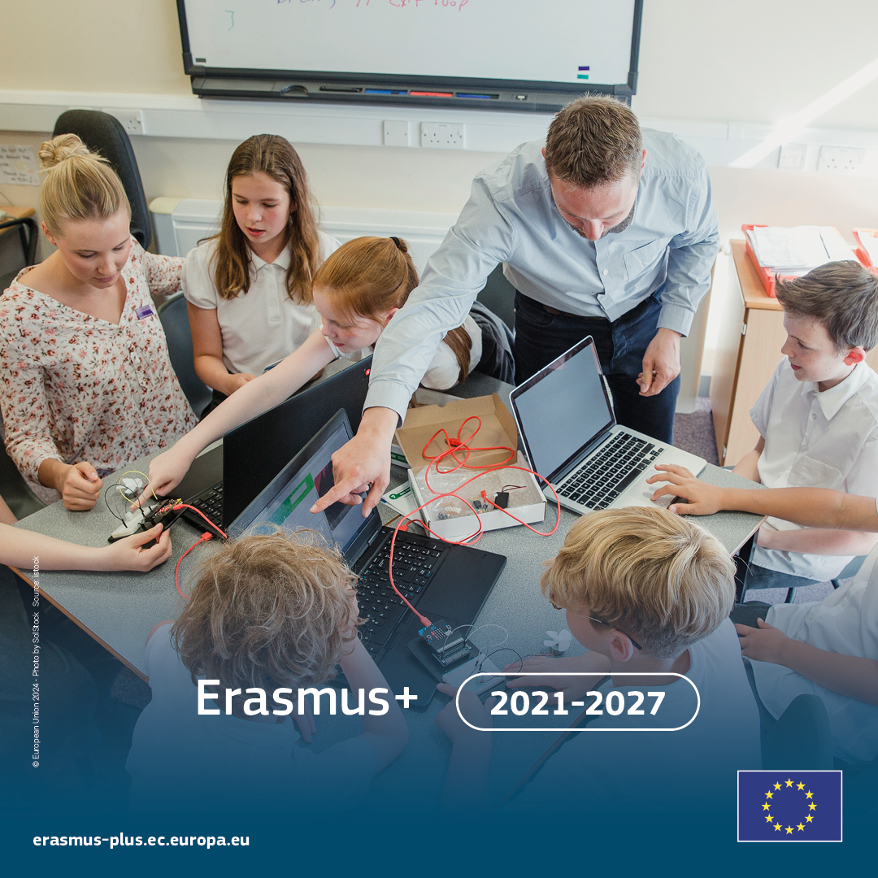
The digital transition starts here
Enriching lives, opening minds.
EUROPEAN UNION

Slide 11
Civic engagement starts here
Enriching lives, opening minds.
EUROPEAN UNION

Slide 12
Inclusion and diversity start here
Enriching lives, opening minds.
EUROPEAN UNION

